Slide 1
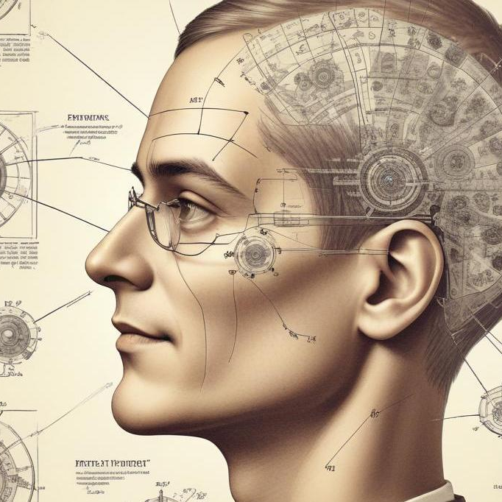
NAVIGATING INTELLECTUAL PROPERTY IN THE AGE OF ARTIFICIAL INTELLIGENCE AND GLOBAL CHANGE
BY
Joseph Jar Kur
Professor
LLB,BL, LLM, PhD
jkur@utg.edu.gm

Slide 2
INTERFACE BETWEEN IP AND AI
Core Learning Objectives for the participants include to:
Link Intellectual Property Rights (IPRs) and Artificial intelligence (AI)
Appraise conflicts between traditional IP principles and AI Capabilities- Authorship, Originality and Infringement in AI-generated works
Examine select legal frameworks in Nigeria, Gambia in the face of ‘Global Change’
Evaluate Fair Use and Fair Dealings concerns in AI application tools.

Slide 3
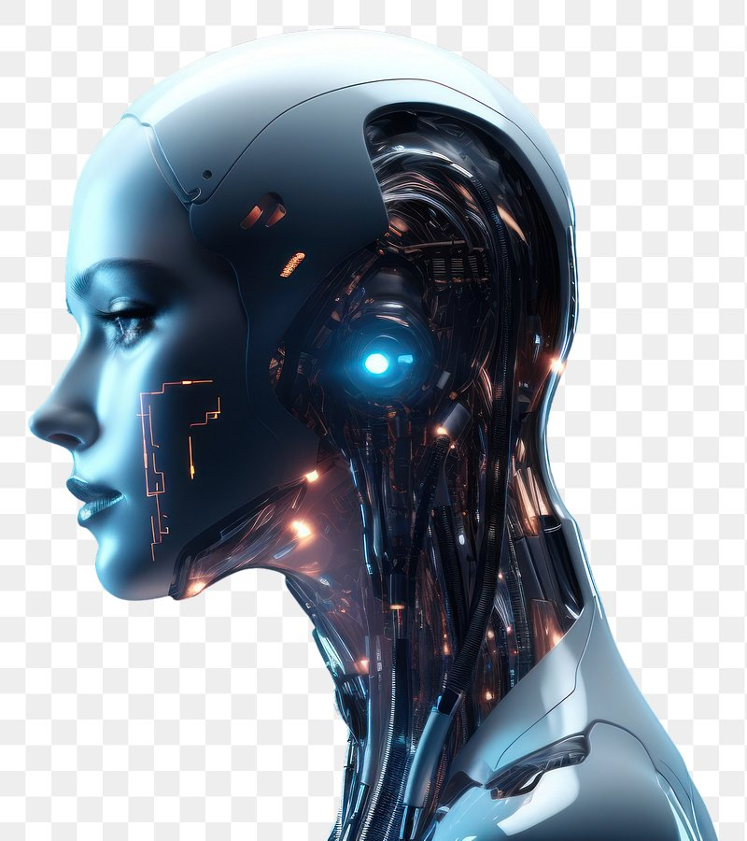
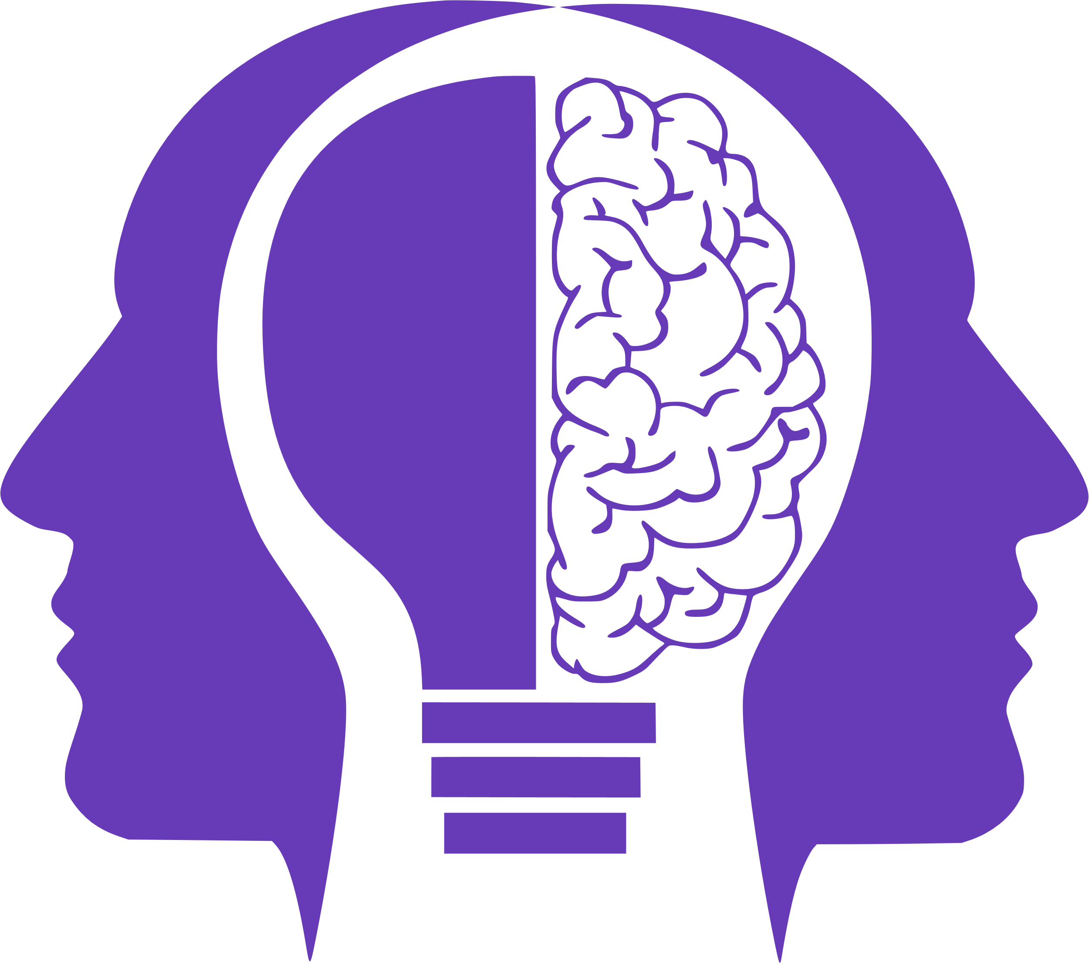
The interface of IP with AI has ignited a mixed feeling of admiration on one part and apprehension on the other part.

Slide 4
INTRODUCTORY AND BACKGROUND SETTING
The discourse and interface on navigating Intellectual Property (IP) in the age of Artificial Intelligence(AR) is both timely and necessary because we are living in an era where machines no longer merely assist us, they create with us, and sometimes, they appear to create for us.
We now live in an ‘era of machines validating humans’ ( we are validating if you are human, says the machine) (circle all the pictures where bicycle appears) are common interface to establish we are not robots.
Historically, humans created, humans validated. The Doctor examines a patient and prescribe drugs or perform an operation or the techer grades an essay. Today, humans create and machine validate. AI prescribe drugs to the patient. AI scores your job interview. Algorithms decide if your art is ‘original’ creation. Software checks if your code is good enough.

Slide 5
INTRODUCTORY AND BACKGROUND SETTING
Truly, humanity is being authenticated by codes: The copyright office requires proof of human authorship; Social media, the Instagram verifies ‘real person’ via AI face scans; AI credit scores a customer if he qualifies for a loan; in schools and education, Turnitin AI detector flags similarity index.
Today, Artificial Intelligence (AI) writes articles, composes music, paints portraits, drafts legal documents, Decide disputes between parties, Generate evidences for the courts, diagnoses diseases, creates films, designs logos, and even invents technological solutions. These are all tasks hitherto performed exclusively by humans and is protected by intellectual property rights as exclusive rights.

Slide 6
INTRODUCTORY AND BACKGROUND SETTING
The foregoing raises important legal, philosophical and ethical puzzles such as:
Who owns what AI creates?
Can a machine be an author?
Can AI infringe copyright?
Can an invention made by AI be patented?
Can a company register a trademark generated by AI?
Can data used to train AI amount to theft of intellectual property?
These are no longer futuristic questions. They are present-day legal realities and our discussion today focuses on how intellectual property law responds to these questions and current realities. .

Slide 7
MEANING OF INTELLECTUAL PROPERTY RIGHTS
Intellectual property right (IPRs) is defined by the World Trade Organization (WTO), as rights given to people over the creation of their minds” and owners of these rights otherwise known as “creators can be given the rights to prevent others from using their inventions, designs or other creations.
The World Intellectual Property Organisation (WIPO), define IPRs as creations of the mind-everything ... include rights relating to literary, artistic and scientific works: performances of performing artists; phonograms and broadcast; industrial designs; trademarks, service marks, commercial names and designations; protection against unfair competitions; and all other rights resulting from intellectual activity in industrial, scientific, literary or artistic fields

Slide 8
CLASSIFICATION OF RIGHTS UNDER IPRs
Intellectual property (IP) has two major components, Industrial Property and Copyright, generically refers to as ‘Intellectual Property Rights ’(IPRs).
The rights are protected through the regimes of:
Statutes; (Copyright, Patents, Industrial Designs, Trademarks and Service Marks) Plant Variety Act; Data and Database Protection (in modern practice)
common law; (Trade Secrets, Confidential Information)
Contract (Layout of Integrated Circuits) and
Sui Generis (Plant Breeder Rights)

Slide 9
CLASSIFICATION OF RIGHTS UNDER IPRs
Intellectual property are human mind creations. These includes books, music, paintings, inventions, software, films, logos, designs, and confidential business information
Unlike land or cars, IP is intangible, you cannot touch it, but it has enormous value.
For example, you cannot touch the Coca-Cola formula, but it is worth billions. You cannot physically hold the brand “Google,” but it is one of the most valuable assets in the world. IP law protects these creations and gives creators legal rights over them.
The major branches of IP include: Copyright; Patent; Trademark; Industrial Design; Trade Secrets and Data and Database Protection (in modern practice)

Slide 10
EFFECTS OF IPRs
These Intellectual property Rights (IPRs) constitutes the old testaments regime of Laws that is based on the following strict monopoly principles:
Rights enjoyable only by humans and are projected on reward for contributions to humanity.
The humans are granted Legal ownerships of control through ‘exclusive rights’ to restrain third party participation without authorization, otherwise it becomes infringement.
The IPRs are privately owned and the balance of control or equitable balance tilt in favour of private than public enjoyment of the product.

Slide 11
CLASSIFICATION OF RIGHTS UNDER IPRs
AI outputs belong to the public domain by default, by operation of law and not by choice because it has no owner.
Artificial Intelligence on the other hand constitute a new set of legal interest/issues that may require new rights. Currently, operatable on OpenAI terms of service
Currently, AI is not recognised nor protected by any statute. No country has granted AI rights
Lacks clear ‘owner’ status.
No exclusive rights granted to AI
No available remedies for infringement
Currently, there is gap of protection for AI IP

Slide 12
DEDUCTIONS FROM DEFINITIONS OF IPRs
The definitions are many, however, it is important to deduce from the above discourse that:
Intellectual property (IP) are only creations of the “Human” mind and can only be owned by human beings whether in patents, copyright or trademark etcetera. Under the Nigerian Copyright Act, 2022, an author is defined as a “person” responsible for creating a copyrightable work.
However, the Act does not provide a definition for the word “person” but it means any human being who creates a work as author (thereby not giving room to any broader definition other than human beings) excluding any bionic entity, such as “Generative AI”
By the Copyright Act of Nigeria, ‘an author’ does not include a machine or artificial persons other than a company

Slide 13
DEDUCTIONS FROM DEFINITIONS OF IPRs
Key references to ‘persons’ appears in who an author is (see s5 & 108) limiting the section to natural humans and companies excluding AI
Ownership of copyright (see s) defining ‘person’ and limiting to author, employer, commissioner, assignee as persons who can own excluding AI
Infringement liability (see s) subjecting criminal liability to ‘person’ including individuals and companies
Cause of action suits (see s) limiting only the copyright owner or authorized person to possessing the requisite locus to sue, excluding AI
B. Animals cannot own intellectual property.(Creative works made by animals do not have any spectrum of right to their own whether the work is created independently by the animal or works created by animals under some form of human intervention.

Slide 14
MEANING OF ARTIFICIAL INTELLIGENCE (AI)
AI is the simulation of human intelligence by machines, especially computer systems.
AI is a branch of computer science concerned with building systems that can perform tasks typically requiring human intelligence such reasoning; problem-solving; perception; understanding language, and decision-making
AI reasons like human beings; analyse data, recognizes patterns; makes decisions; make predictions with minimal human intervention.
AI is a smart technology that mimic humans in a variety of way such as writing, drawing, driving, diagnosing, content generation etc

Slide 15
MODELS OF AI
Examples of AI include:
ChatGPT
Midjourney
Gemini
Grammarly
Claude etc used for different purposes
There are two broad AI categories relevant to IP:
(a) Assistive AI: This helps humans create. For example where a lawyer uses AI to summarize cases.
(b) Generative AI: This independently produces content. For example where an AI creates a song from a text prompt. This second category creates the biggest IP problems.

Slide 16
INTELLECTUAL PROPERTY AND ARTICIAL INTELLIGENCE: INTERFACE
IP is the foundational enabler or emergence of the AI tools through inventions, (such as novel algorithms with specific model weights, parameters, which are protected through trade secrets); (Patents law or trade Secret protection)
The algorithmic protection vide copyright (which may be by way of software code implementation);(Copyright Law)
The need to guarantee and secure the high quality legal data acquired, where AI developers obtain access to materials on fee from publishers and creators, giving rise to data licensing market are all indices to the role of IP in been instrumental to the emergence of AI. (Data protection Law)

Slide 17
OTHER PROPRIETARY INTEREST IN INTELLECTUAL PROPERTY AND ARTICIAL INTELLIGENCE: INTERFACE
Software embedded in the operating systems as an AI tool may either proprietary (closed-source) software or open-source software, controlled by copyright under terms and conditions.
The ownership of proprietary rights in ICT platforms or other digital content is protected firmly in intellectual property rights either in copyrights, patents, utility models, industrial designs, trademarks or service marks, integrated circuits either exclusively or in combination or through special contract law.

Slide 18
CAN AI BE AN AUTHOR AND OWNER UNDER COPYRIGHT LAW?
The first big question and indeed most controversial issue is whether AI can be an author or owner within the context of copyright laws now presently constituted?.
Tradionally, Copyright protects original works such as books, songs, films, software, photographs, artistic works. Traditionally, copyright assumes there is a human creator. But what happens when AI creates a work?
For example: a student types, AI write me a Poem and AI produces a beautiful poem.
Who owns it?
Is it the student?
The software company?
The programmer?
or nobody? This is where the law becomes interesting.

Slide 19
SKEPTISM OF IP
OWNERSHIP/ AUTHORSHIP LIMITATIONS:
Copyrights and patents law are highly skeptical of AI works and products in respect of ownership.
The Copyright Act 2022 of Nigeria, does recon with generative AI like ChatGPT which can simulate human like conversations, answer questions, perform research, compose musicals and even write lines of code.
Section 2(2)(b) of the Act however, signifies a possibility that may accommodate AI works when it provides for fixation of a copyrighted material in ‘a medium known or later to be developed’ which is a proviso that green light AL-generated works. (Notwithstanding the possibility, the question that will come to mind is whether the wordings of the proviso contemplates creation of the work itself because, creation cannot be by a medium).

Slide 20
SKEPTISM OF IP
OWNERSHIP/ AUTHORSHIP LIMITATIONS:
This is extremely important for AI-generated works. If there is no meaningful human intellectual contribution, originality may fail. Under Section 108 (Interpretation Section), the concept of “author” clearly assumes a legal person and not a machine.
This means that Pure AI-generated works may not enjoy copyright protection in Nigeria. If there is no meaningful human creative contribution, there may be no copyright and this is consistent with global thinking.
Practical Example
If I simply type, AI write a motivational speech for me and AI produces the entire speech with no substantial human creativity from me, ownership becomes doubtful.
But if I substantially edit, restructure, improve, and creatively transform it, then my human contribution may attract copyright protection. The law protects human originality, not mere button-clicking.

Slide 21
SKEPTISM OF IP
International Authorities on Human Authorship
The case of Thaler v. Perlmutter is another pointer with international dimension, where Stephen Thaler attempted to register copyright for an artwork created entirely by his AI system. The U.S. courts rejected it with the reasoning that human authorship is a fundamental requirement of copyright.
This case has become one of the strongest modern authorities on AI-generated works. It strongly supports the position for adoption.

Slide 22
AI AND COPYRIGHT INFRINGEMENT: THE TRAINING DATA PROBLEM
Another challenge of AI with IP particularly copyright infringement battle. AI systems are trained using massive volumes of data such as books, songs, artworks, newspaper articles, legal materials, academic journals, photographs e.t.c which are subject to copyright control and ownership.
The big question becomes: Is training AI on copyrighted works an infringement?
Suppose an AI company copies 5 million books to train its model, can the authors sue? Many say yes.
AI companies often argue: “We are not copying for sale; we are learning patterns.”
Creators respond: “You are using our work to build billion-dollar systems without permission.”
This is one of the biggest copyright battles globally.

Slide 23
THE COPYRIGHT AND AI SETTLEMENT
It is reported that, 480,000+ authors representing 91% of works, comprising of copyright holders have have filed a settlement class action claiming $1.5 billion from Antropic over the unauthorized use of books in AI training.
The case stems from allegations that, Anthropic used pirated books to train its AI models, Claude- raising serious questions about how AI systems learn and where the data comes from.
While many call this settlement historic, authors argue that, the pay isn’t large enough because, legal fees are high and certain international creators are excluded.
This case is symbolic because, it will reshape how AI companies handle copyrighted content and will redefine fair use in the age of AI

Slide 24
FAIR DEALING AND AI TRAINING
Fair Dealing or Fair Use: Nigeria recognizes fair dealing Under Section 20 of the Copyright Act 2022. This allows limited use of copyrighted works for purposes such as: research; private study; criticism; review; reporting current events.
However, scholars have argued that these exceptions were designed for human use and may not easily fit large-scale AI training and commercialization.
For example: A student quoting two paragraphs in research is different from a company feeding 10 million books into an AI model.
So the law is still catching up. This area urgently needs legislative clarification.

Slide 25
AI AND PATENT LAWs
Patents protect inventions and new creations such as new medicines, machines, engineering processes, software-based technical inventions. However, the classic rule is that the inventor must be identifiable. But what if AI invents something?
AI has interfaced with inventiveness in a smart manner that, an AI system discovers a new pharmaceutical formula faster than any scientist. Legal issues that will arise here would be, Who is the inventor?
Patents and Designs Act, qualifies an invention as patentable only if it is new, results from inventive activity, and is capable of industrial application.
Further, Section 2 provides that the right to a patent belongs to the statutory inventor as against the true inventor.

Slide 26
AI AND PATENT INTERFACE
AI interfaces with patent in two directions:
Is AI itself patentable? Can AI be an Inventor?
Can an AI model such as algorithm or system be subject of invention? No. A mathematical algorithm alone is abstract and not patentable and excluded.
What about training Data? No. Facts and discoveries are not inventions
What about the hardware running the model? Yes. Patentable because physical system is clearly technical solution to a technical problem
Section 1(5)PDA excludes ‘computer programs’ but not inventions using them.
Best strategy to patent an AI is System + Method =Claim. You are patenting the factory system, not just the AI. The invention can then be a better computer( handset), not maths; you cannot patent ChatGPT but you can patent a model computer that uses seismic analysis of the apparatus.

Slide 27
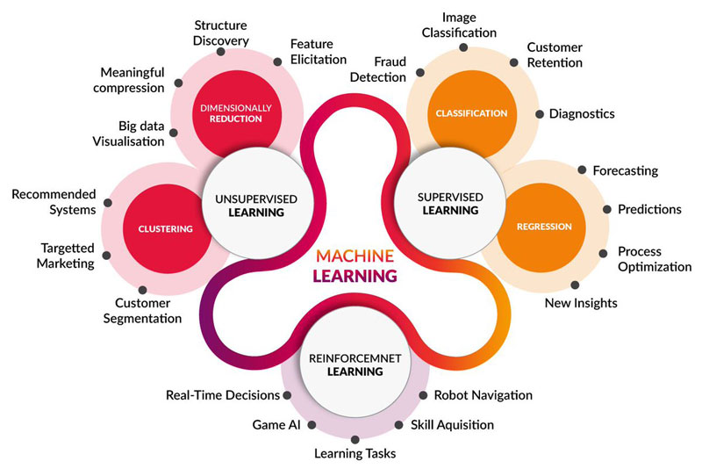

ALGORITHM IS A STEP BY STEP SET OF INSTRUCTIONS TO SOLVE A PROBLEM OR COMPLETE A TASK
ALGORITHM ABSTRACT MODEL
NOT PATENTABLE
COMPUTER FUNCTIONALITY WITH ALGORITHM ABSTRACT IMBEDED
PATENTABLE
This Photo by Unknown Author is licensed under CC BY

Slide 28
AI AND PATENT LAWs
Who then is a statutory inventor? This strongly suggests that inventorship belongs to a natural person and not an artificial intelligence system.
This question arose globally in the famous DABUS cases. Stephen Thaler listed his AI system, DABUS, as the inventor and most patent offices including the US, UK, and Europe refused.
Their reasoning was that only a natural person can be an inventor. Nigeria would likely follow this human-centered approach.
Thus, AI may assist invention, but legal inventorship still belongs to humans.

Slide 29
AI AND PATENT LAWs
Patent law is not yet to accommodate and provide clear guidelines on suitability and patentability as well as inventorship of AI inventions. This creates the challenge of AI and Inventorship in Patents
Questions whether, AI would be an inventor for the purpose of been granted the status of an invention remain unresolved.
However, In Commissioner of Patents v Thaler, the Court held that an invention devised by an AI system is not patentable. The Court observed that, the grant of a patent under the Patents Act 1990 is based upon an invention that arises from the mind of a natural person. This outcome reinforces patent’s historical grants been anchored on the grant of monopolies as a reward for human endeavour and not machines.
Thaler v. Vidal’s case in the U.S followed the trend as well as the case of
Thaler v Comptroller-General of Patents, Designs and Trademarks case filed in the UK.

Slide 30
TRADEMARK ISSUES IN THE AI ERA
AI interfaces with trademarks in three main ways:
As an infringer: When prompted, can generate ‘a confusingly similar/ identical logo or mark’ of an already existing or registered logo thereby eliciting a dispute for the applicant.
As a creator: A prompt may generate or create a distinctive trademark that is unique and registrable by the proprietor.
As an enforcement tool: AI scans Amazon, Instagram, web for counterfeit logos/images and therefore can become a good enforcer to detect infringements, border monitoring for Customs. It is an enabler for e-filing checks etc.

Slide 31
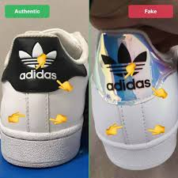
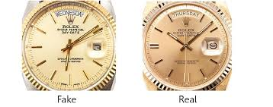

Slide 32
TRADEMARK ISSUES IN THE AI ERA
Trademarks protect names, logos, slogans, brand identity. For example Nike, MTN, Dangote, Apple e.t.c
AI can now generate logos, slogans and even brand names.
Under Section 9 of the Trade Marks Act, a trademark must be distinctive.
Also, Section 13 provides that registration may be refused where a mark is likely to deceive or cause confusion.
AI may unintentionally generate a logo too similar to an existing trademark. Therefore, where AI generates a logo too similar to an existing brand like Coca-Cola, trademark registration may fail and infringement liability may arise.
The user may face legal liability, even if the AI made the mistake.

Slide 33
DATA PROTECTION, AI AND INTELLECTUAL PROPERTY
Data protection, Artificial intelligence and intellectual property interfaces differently (clashes) and jointly overlaps.
IP create the data in books, inventions etc and grant monopoly rights. The right owner can only licence and assign the right
The Data Protection Act 2023 (NDPA), protects the processing of personal data and grant privacy rights and limit the process of personal data (names, addresses, age, phone number etc) and subject it to express consent or permission.Under Section 24 of the NDPA, personal data must only be processed on a lawful basis such as consent, contractual necessity, legal obligation, public interest, or legitimate interest.
AI now uses the data to model or train its tools

Slide 34
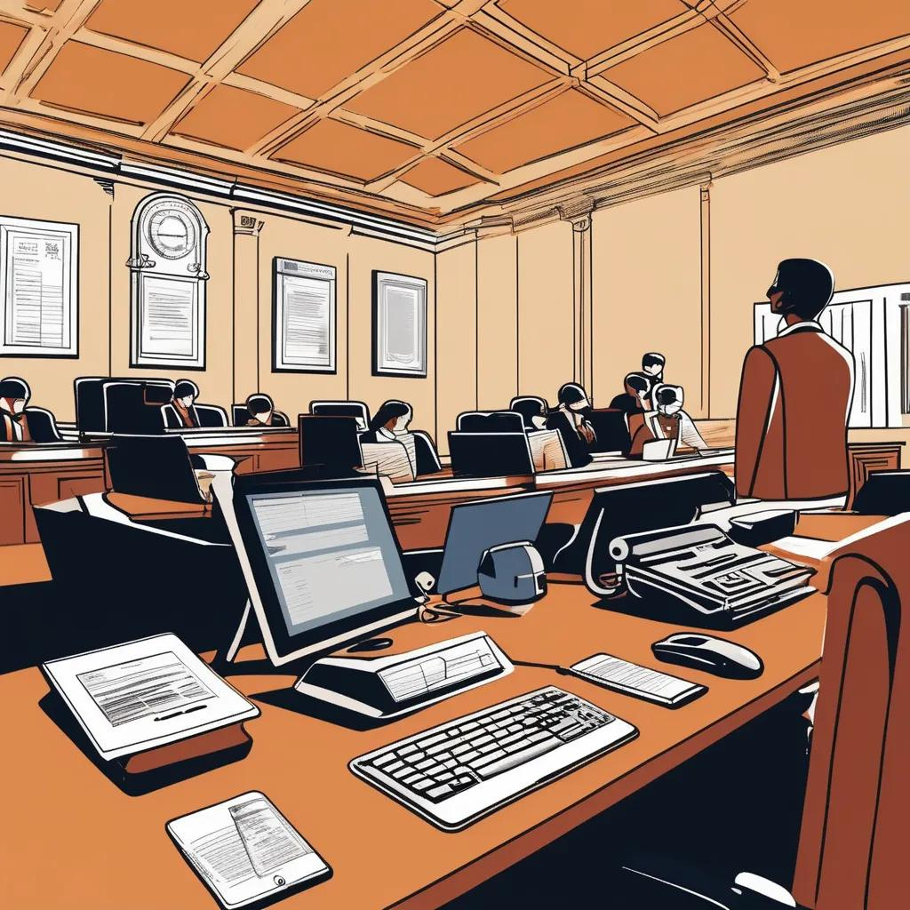
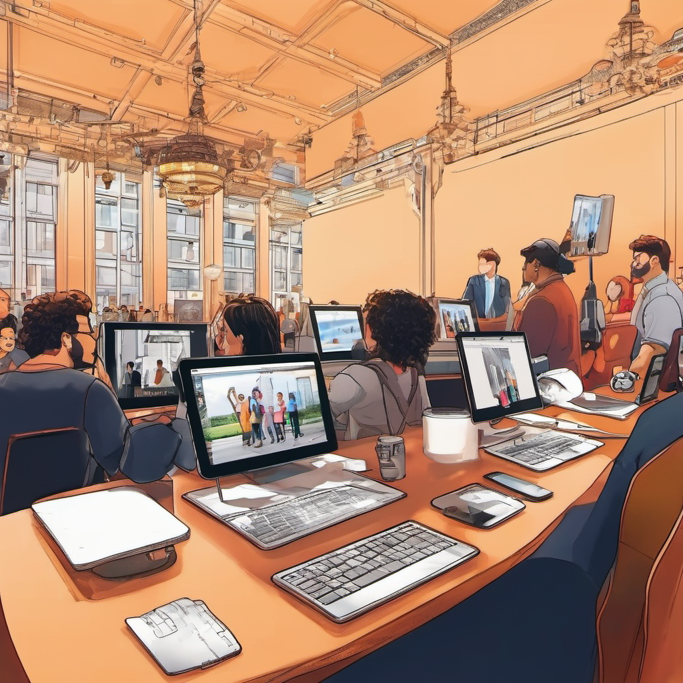
IP AND DATA PROTECTION

Slide 35
DATA PROTECTION AND AI
AI feeds on data and a lot of that data is personal data.
The Nigeria Data Protection Act 2023 (NDPA), which establishes comprehensive rules for processing personal data and creates the Nigeria Data Protection Commission.
Under Section 24 of the NDPA, personal data must only be processed on a lawful basis such as consent, contractual necessity, legal obligation, public interest, or legitimate interest.
Also, Section 25 provides that consent must be clear, informed, specific, and freely given.
Further, Section 37 protects the rights of data subjects including the right to information, correction, deletion, and objection.

Slide 36
DATA PROTECTION AND AI
Violation may attract penalties under Section 48.
This means that if AI systems use personal data without lawful basis, consent, or transparency, legal consequences may follow.
Example: An AI recruitment system secretly uses applicants’ personal information without proper disclosure. That may trigger liability under the Data Protection Law.
So AI governance is not only about innovation. It is also about rights, dignity, and accountability.

Slide 37
TRADE SECRETS AND CONFIDENTIAL INFORMATION
This is especially important for lawyers and businesses. When professionals input confidential information into public AI tools, they may unknowingly expose the confidential information/ trade secrets.
Example: A lawyer uploads a confidential contract into an open AI platform for drafting assistance. That may compromise client confidentiality, privilege, trade secrets, regulatory compliance.
Under Rule 19 of the Rules of Professional Conduct for Legal Practitioners 2007, a lawyer has a strict duty of confidentiality and must not disclose client information.
Uploading confidential legal documents into public AI systems may amount to professional misconduct.
This is not merely an IP issue, It is also an ethical issue.
Lawyers, doctors, and corporate professionals must exercise caution. Convenience should never defeat confidentiality.

Slide 38
NAVIGATING THE FUTURE
NAVIGATING THE FUTURE: LEGAL AND PRACTICAL SOLUTIONS FOR INTELLECTUAL PROPERTY INTHE AGE OF AI
Having examined the challenges AI poses to intellectual property law, the more important question becomes how do we respond in a way that protects creativity without stifling innovation? The solutions must operate at three levels:
Legal and regulatory reforms
Institutional and professional practices
Technological and ethical governance

Slide 39
LEGAL AND REGULATORY REFORMS
LEGAL AND REGULATORY REFORMS: UPDATING THE LAW TO REFLECT REALITY
One of the clearest realities of IP law today is that it is still largely human-centric, while AI is now actively participating in creation.
Under legal and regulatory reforms, the following should be enforced:
1. Defining “AI-Assisted” vs “AI-Generated” Works
A major reform needed is legal classification. The law should distinguish between AI-assisted works, where a human meaningfully directs the creative process and AI-generated works, where output is produced with minimal or no human creative input. This distinction matters because this clarity reduces litigation and uncertainty.
For example, a lawyer using AI to draft a contract is AI-assisted while a user pressing “generate poem” with no edits is AI-generated

Slide 40
LEGAL AND REGULATORY REFORMS
2. Express Recognition of Human Authorship in Statutes
Most IP laws, including Nigeria’s Copyright Act 2022, implicitly assume human authorship.
However, future amendments should make it explicit like, “an author shall be a natural person who contributes intellectual creativity to a work.” This prevents unnecessary litigation over whether AI can be an author.
It also aligns with global jurisprudence like the UK Copyright, Designs and Patents Act approach

Slide 41
Introduction of a “Sui Generis” Protection for AI Outputs
This is a very important modern proposal. Instead of forcing AI outputs into traditional copyright rules, lawmakers could create a new category of protection. A sui generis (unique) regime for AI-generated content.
This could include limited duration protection, rights assigned to developers or users, reduced protection compared to human works. This approach balances innovation incentives and public access
4. Regulation of AI Training Data Use
One of the most contentious areas is data scraping and model training. Future laws should clarify:
When copyrighted materials can be used for AI training
Whether opt-in or opt-out systems apply
Whether licensing is required for commercial AI systems

Slide 42
Strengthening Enforcement Mechanisms in Nigeria
Even good laws are ineffective without enforcement. Nigeria should strengthen:
i. The Nigerian Copyright Commission
ii. Digital monitoring tools
iii. IP dispute resolution mechanisms
AI-related disputes will be technical and fast-moving. Traditional litigation alone may be too slow.

Slide 43
INSTITUTIONAL AND PROFESSIONAL SOLUTIONS
Law is not only made by courts and parliament. Institutions shape how law works in practice.
1. AI Compliance Policies in Organisations
Every organisation using AI should adopt internal rules: For example:
Disclosure when AI is used in content creation
Review of AI-generated output for infringement
Restriction on uploading confidential data into AI tools
For legal scholars and law firms especially, Ai should assist and not replace professional operations.

Slide 44
IP Education for Legal and Tech Professionals
Many IP disputes today arise not from bad faith, but from ignorance. Universities and professional bodies should integrate disciplines like AI law, data governance and AI governance into core curricula. Because tomorrow’s IP lawyer is also a technology interpreter.
In our current age, the complete band of AI might be impossible for scholars to adhere to and thus educational institutions should develop AI usage policies in order to preserve and protect academic integrity.

Slide 45
Clear Contractual Clauses in AI Use
Businesses should not rely on assumptions. Contracts with AI providers should clearly state:
ownership of outputs
liability for infringement
confidentiality of inputs
permitted use of generated content
For example If a company uses an AI tool to design its logo, the contract should state whether the company owns the design or only has a licence to use it. Without this, disputes become inevitable.

Slide 46
Professional Ethical Guidelines
Bar associations, design councils, and creative industries should issue guidelines. For lawyers specifically, AI must not compromise confidentiality, AI output must always be verified, AI cannot replace legal reasoning. This aligns with existing professional ethics on competence and confidentiality.
C. TECHNOLOGY AND ETHICAL GOVERNANCE
Law alone cannot solve AI challenges.We also need technology-based safeguards such as:
1. AI Transparency and Disclosure Systems
AI-generated content should be clearly labelled. For example, “Generated with AI assistance” or “Human-edited AI content”
This helps prevent deception and protects originality.
2. Watermarking and Content Tracking
Developers can embed invisible identifiers into AI-generated content. This helps trace origin, prevent misuse and identify infringement sources.

Slide 47
CONCLUSION
If we return to the central question, who owns creativity in the age of artificial intelligence?” The emerging global answer is:
i. AI does not own anything
ii. Humans remain the legal anchor of creativity
iii. But humans must now prove their role more clearly than ever before,
Intellectual property law is not disappearing in the age of AI, it is simply being forced to evolve rapidly, and irreversibly.
Artificial Intelligence is not the enemy, it is a tool and like every powerful tool, its value depends on how we use it.

Slide 48
CONCLUSION
The real question is not whether AI will transform intellectual property, it already has. The real question is whether our laws, institutions, and professionals are prepared for that transformation.
As lawyers and scholars, our duty is not merely to follow technological change, it is to shape it because if law does not lead, technology will. And when technology leads without law, rights suffer.
However, while we regulate technology, we must avoid over regulation that kills innovation.
The goal is balance, we must protect creators, inventors, businesses, privacy, and public trust.

Slide 49


